Slide 1
Castle Shannon Borough Six Parks Plus Plan Status Updates March 25, 2024

Slide 2
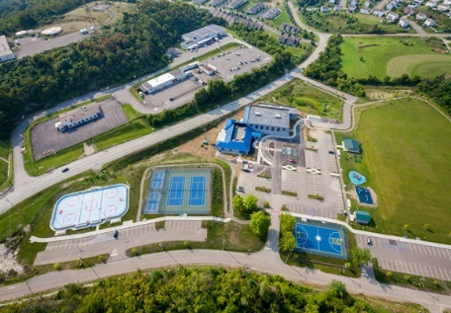
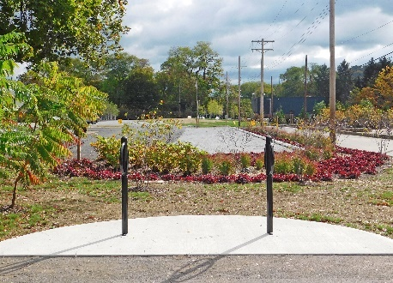
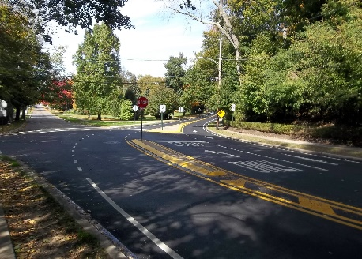
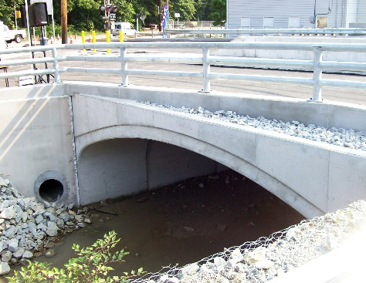
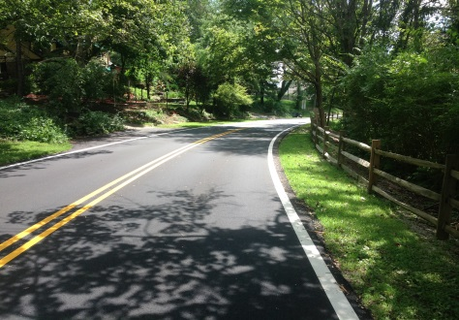
Six Parks Plus Plan Presented to: Castle Shannon Borough April 25, 2022
Headquarters: Coraopolis, PA Branch Offices: Greensburg, PA Erie, PA Dublin, OH Center, PA

Slide 4
Park Groupings / Implementation Plan
Bidding Strategy – February 13, 2023 Council Meeting

Slide 5
Park Grant Funding
Grant Description | Amount
2021 Lower Hamilton Park Trail Improvements CFA/DCED Greenways, Trails and Recreation Program | $50,000
2021 Lower Hamilton Park Pavilion CFA/DCED Greenways, Trails and Recreation Program | $125,000
2021 Gaming and Economic Development Tourism Fund (GEDTF) Redevelopment Authority of Allegheny County*** ***Transitioned from PRP funding to Lower Hamilton Multi-Purpose Structure | $150,000
2022 Hamilton, Municipal Complex, Riehl Park Trails CFA/DCED Greenways, Trails and Recreation Program | $125,000
2022 Gaming and Economic Development Tourism Fund (GEDTF) Redevelopment Authority of Allegheny County | $150,000
2023 PA Small Water and Sewer | $425,000
Total | $1,025,000

Slide 6
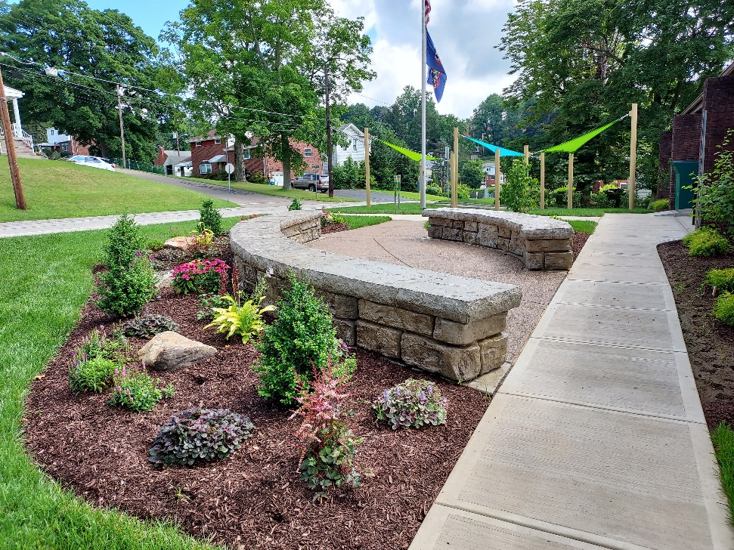
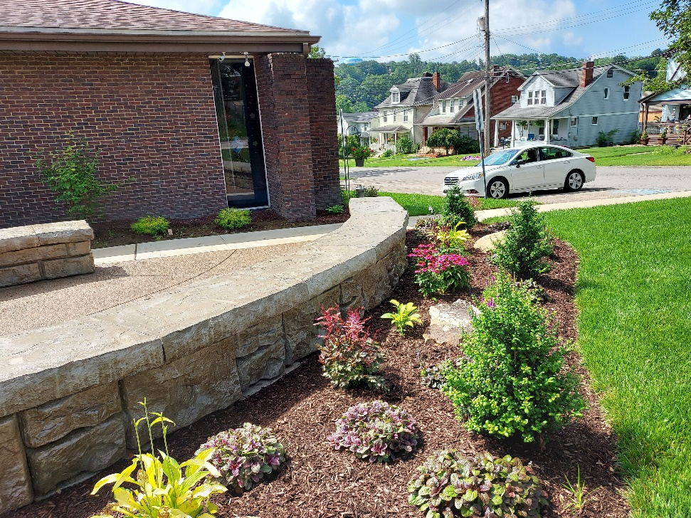
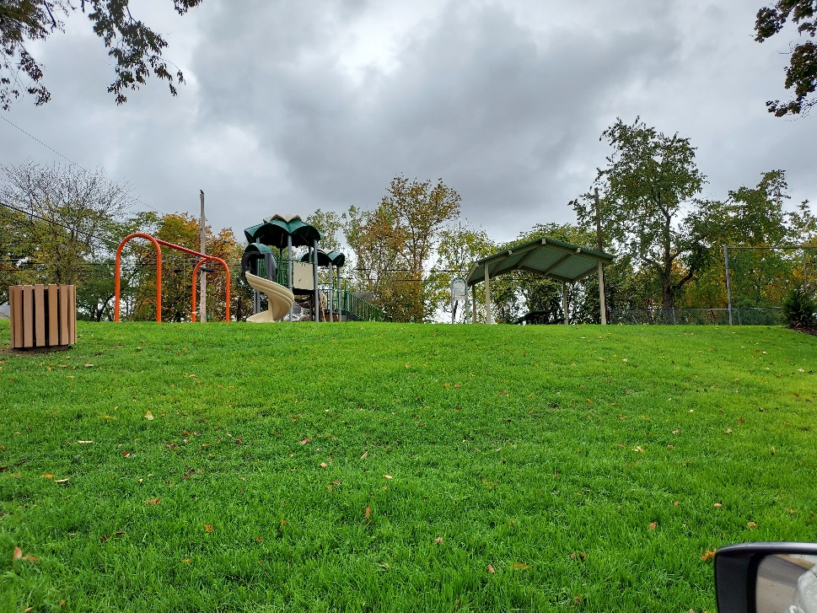
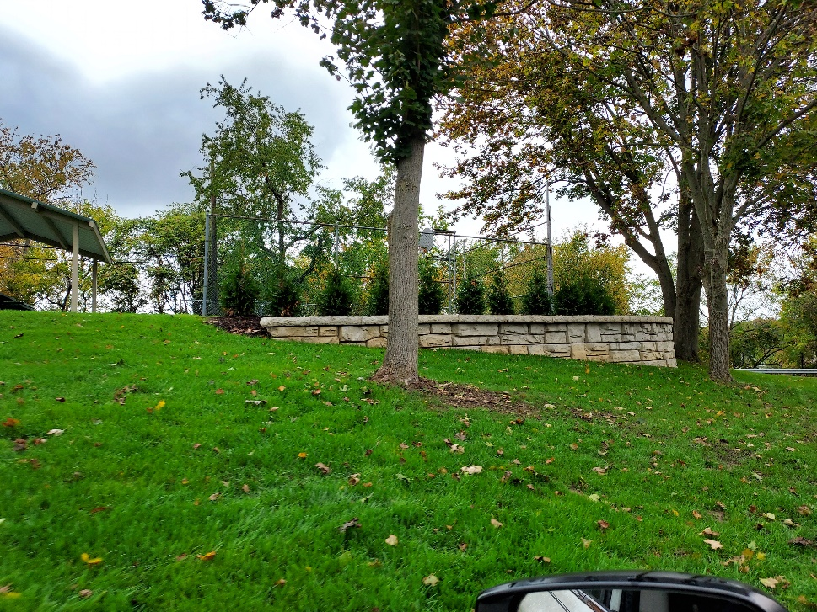
Group 1 Parks (Library, Prospect)

Slide 7
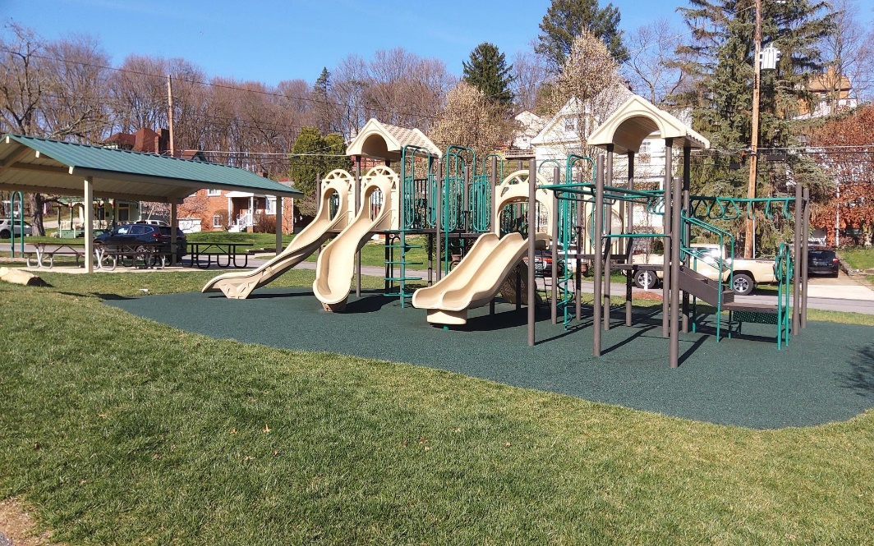
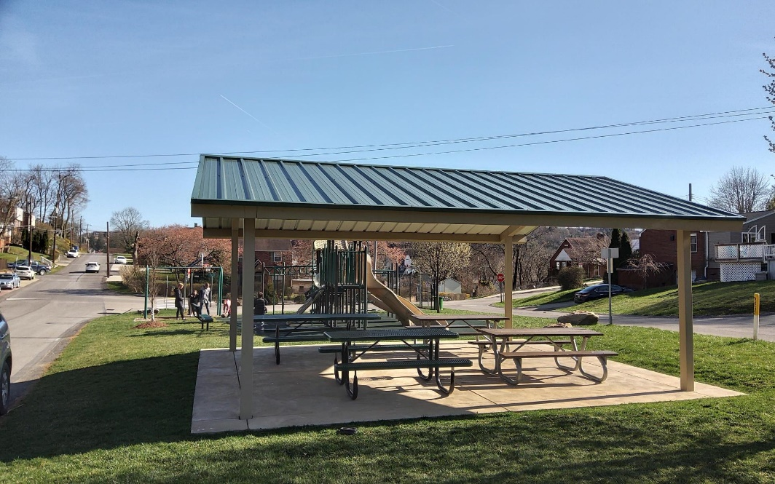
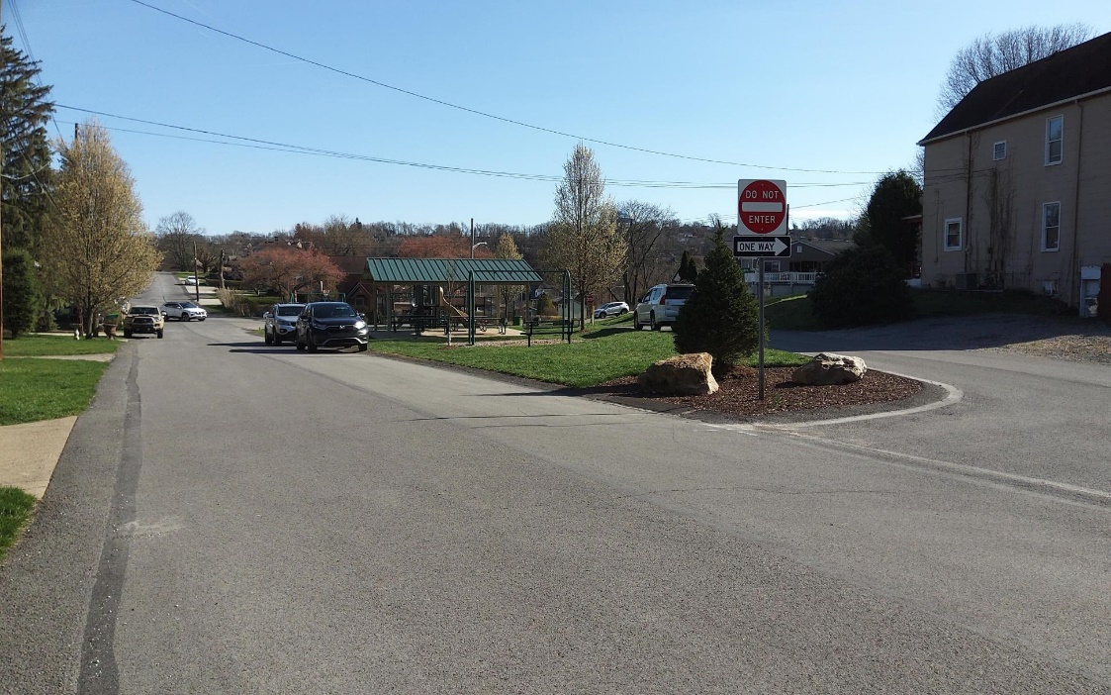
Group 1 Parks (Myrtle)

Slide 8
Group 2 Parks (Lower and Rear Hamilton)

Slide 9
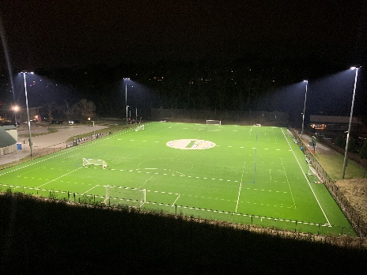
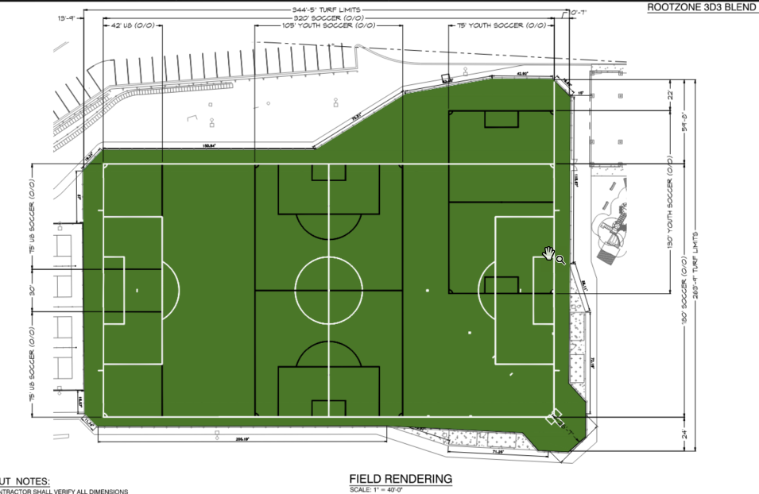
Group 2 Parks (Lower/Rear Hamilton - Contracts / Status)

Slide 10
Group 3 Parks (Upper and Mid-Hamilton)

Slide 11
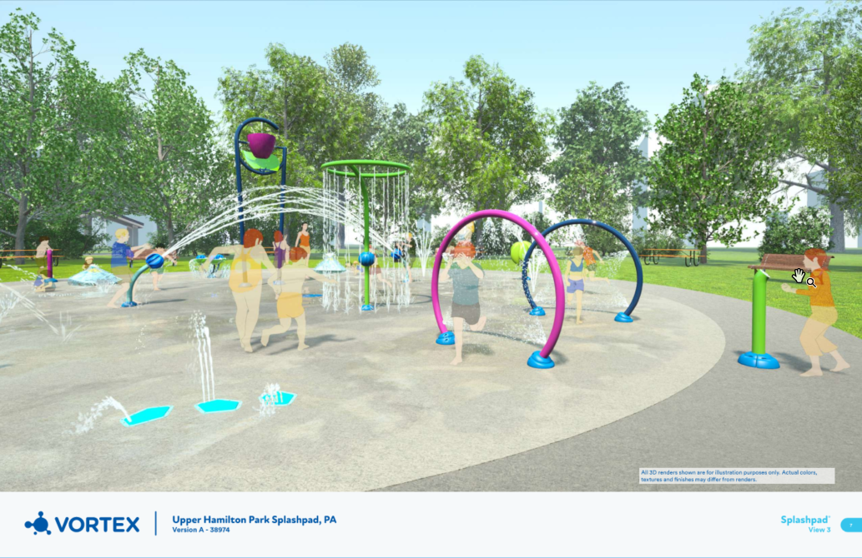
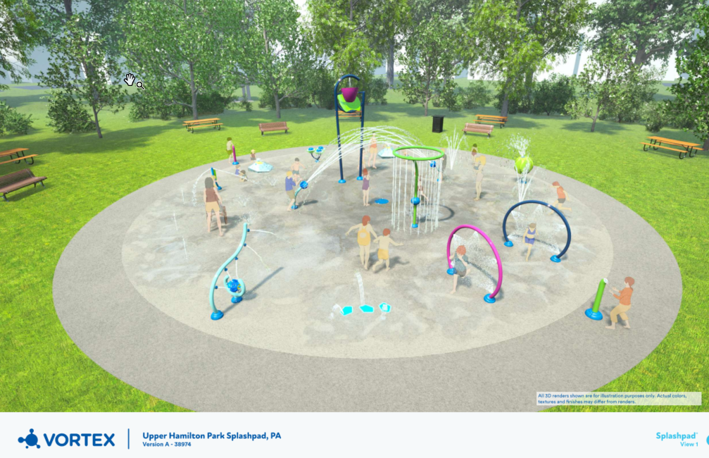
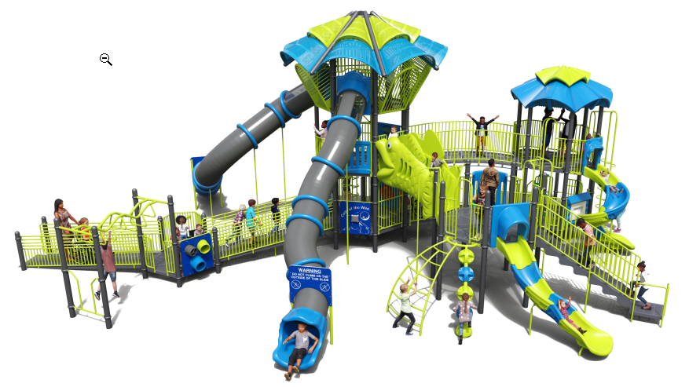
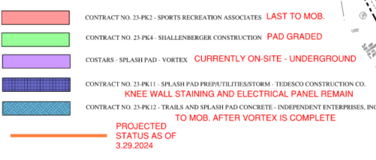
Group 3 Parks (Upper/mid Hamilton – Contracts / Status)

Slide 12
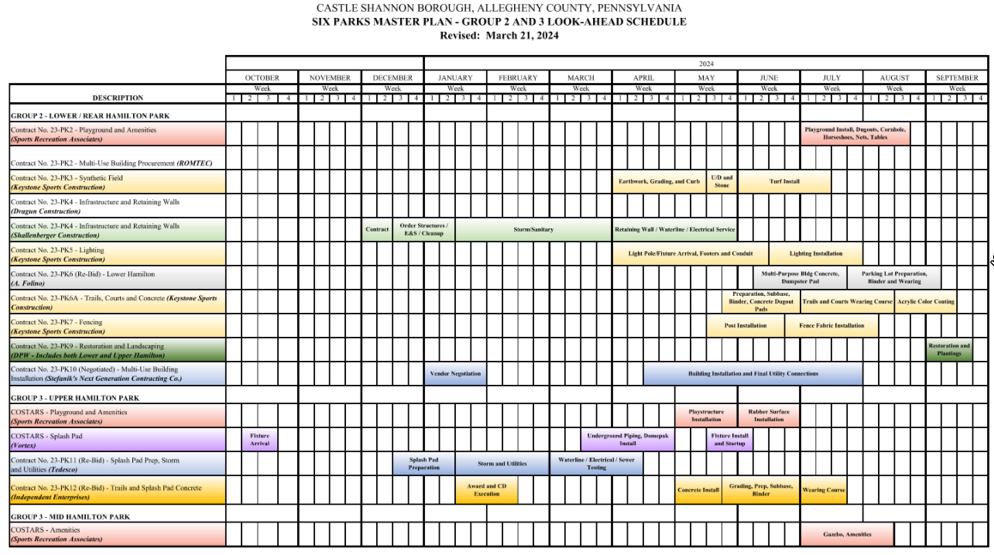
Group 2 / 3 Parks Schedule

Slide 13
Group 4 Parks (Municipal)

Slide 14
Group 4 Parks (Riehl)

Slide 15
QUESTIONS
Jason E. Stanton, P.E. Lennon, Smith, Souleret Engineering, Inc. jstanton@lsse.com
Joshua R. Callender, E.I.T. Lennon, Smith, Souleret Engineering, Inc. jcallender@lsse.com

